Slide 1
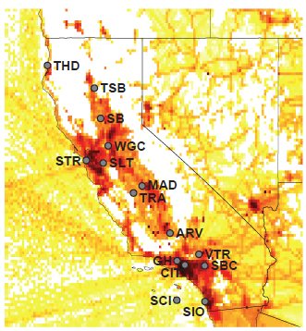
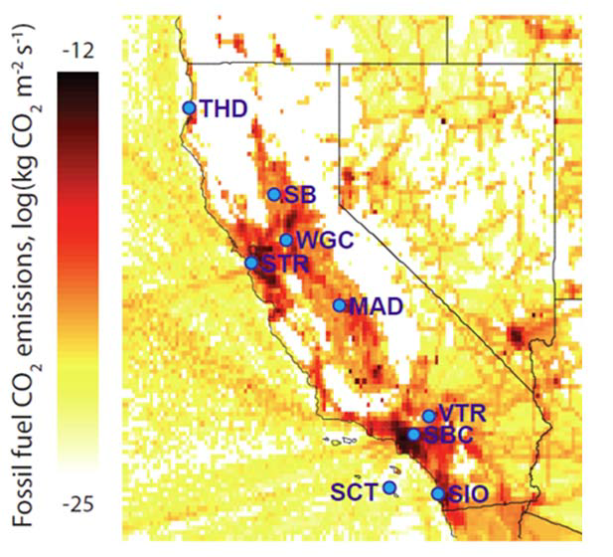
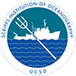
Quantifying fossil and biospheric CO₂ fluxes in California using ground-based and satellite observations
Heather Graven, SIO and Imperial College London
Ralph Keeling and Tim Lueker, SIO
Marc Fischer and Seongeun Jeong, LBNL
Tom Guilderson, LLNL
Nick Parazoo and Christian Frankenberg, JPL
Ying Hsu, CARB
Bill Callahan and Chris Sloop, EN
John Miller, NOAA
Collaborative network of CO₂ observations

Slide 2
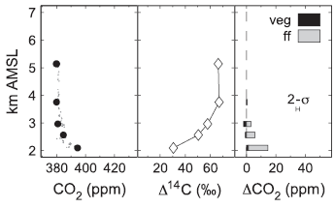
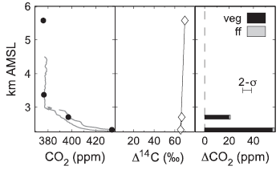
Can we use atmospheric observations to optimize both fossil fuel emissions and biospheric fluxes?
Radiocarbon separates fossil-derived and biospheric CO₂
¹⁴C is produced in the atmosphere and participates in carbon cycle, decaying with ~5000 year half-life
Fossil fuels have no ¹⁴C and dilute ¹⁴CO₂
Linking ¹⁴C with CO can provide information on source type, extend temporal coverage of fossil/biospheric separation
Urban Area: fossil fuel emissions
bio
ff
Rural Area: respiration
bio
ff
Examples from
Graven et al. 2009

Slide 3
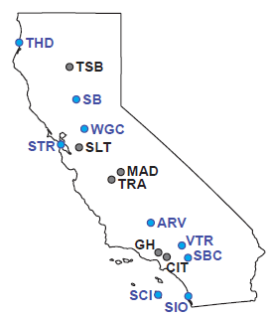
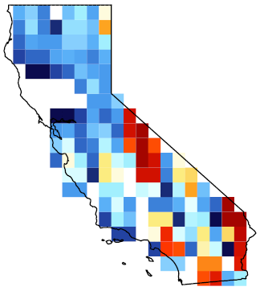
Our pilot project will use observations to estimate fossil fuel and biospheric CO₂ fluxes in California
OCO-2
soundings
Create new data constraints on fluxes:
Field campaigns in May and Nov. 2014 will sample flasks every 3 days at 9 sites for Δ¹⁴CO₂ and CO analysis, supplementing in situ and remote measurements of total CO₂
Tower
Network
6 80
# in Sep ‘10
Develop data-model integration framework to estimate fluxes:
Bayesian inversion using CMS products for a priori fluxes and background CO₂ concentrations, WRF-STILT atmospheric modeling, Δ¹⁴CO₂ and total CO₂ data, including OSSE/pseudo-data experiments and uncertainty quantification
Background
CO₂
A Priori
Flux
Models
WRF-STILT
footprints
CASA-GFED
4D posterior CO₂ fields

